Slide 1
FINAL STAGE PRESENTATION
HEART DISEASE DATASET
Prepared by group 02
TEAM MEMBERS:-
SAI VIPRAJ TELUKOTI
VAMSHI KRISHNA MUMMADI
YASWANTH MULAKALA

Slide 2
INTRODUCTION
Heart Disease is a major health threat, that is why it is important to know risk factors so that proactive measures can be taken before it’s too late. Several health conditions such as lifestyle, age and family history can increase risk for heart disease.
This report aims to highlight factors that contribute to heart disease by analyzing a dataset obtained from Kaggle.
This dataset dates from 1988 and consists of four databases:
1. Cleveland
2. Hungary
3. Switzerland
4. Long Beach V

Slide 3
Data set description
Here’s the description of the variables in the data set:
Age
Sex
Chest pain type (4 values)
Resting blood pressure (in mm Hg on admission to the hospital)
Serum cholestoral in mg/dl
Fasting blood sugar > 120 mg/dl
Resting electrocardiographic results (values 0,1,2)
Maximum heart rate achieved
Exercise induced angina
Oldpeak = ST depression induced by exercise relative to rest
The slope of the peak exercise ST segment
Number of major vessels (0-3) colored by flourosopy
Thal: 0 = normal; 1 = fixed defect; 2 = reversable defect
Target : 1 = Disease, 0 = No Disease

Slide 4
LOGISTIC REGRESSION
Logistic regression is a classification algorithm used to find the probability of event success and event failure. Logistic regression is used when the dependent variable is binary (0/1, True/False, Yes/No) in nature. Logit function is used as a link function in a binomial distribution.
Logistic regression is also known as Binomial logistics regression. It is based on sigmoid function where output is probability and input can be from -infinity to +infinity.
Logistic regression will be used to a generate a model that can predict the heart disease in patients. For the sake of this data, logistic regression is the ideal choice for two reasons.
They are: -
Firstly, the target (dependent) variable in the model is binary; secondly, it is a predictive analysis and can be used to explain the relationship between one dependent binary variable with multiple predictors.
Since resting blood pressure and cholesterol were log transformed it may be difficult to interpret it. Hence, additional feature engineering step will be carried out. Standardization of these variables will enable us to interpret the effects in terms of standard deviation.

Slide 5
IMPLEMENTATION OF LOGISTIC MODEL
Since the model incorporated logistic regression, the coefficients above correspond to log odds value. These coefficients directly do not state anything except that there is a positive relationship. The p-value is very small, which indicates that this relationship is statistically significant. Therefore, to understand and interpret this relationship more accurately, odds ratio will be computed.
Intercept will be ignored as it does not give any relevant information. However, rest of the coefficients will be interpreted as following:
Age: odds ratio of 1.060 can be interpreted as - increasing age by 1 year is associated with 1.06x increase in odds of getting a heart disease. in other words, aging 1 year is associated with a 6% [100 x (1.060 - 1)] increase in the odds of getting a heart disease.
• Sex: It is important to note that the odds ratio of 5.505 represents the odds of going to from female to male (since 0 = female and 1 = male). Hence, it is interpreted as, being a male is associated with 5.505x increase in odds of getting a heart disease.
• Chest Pain: odds ratio of 0.347 can be interpreted as increase in chest pain level by 1 lead to 65.3% [100 x (1 - 0.347)] decrease in heart disease

Slide 6
IMPLEMENTATION OF LOGISTIC MODEL
Results between the training and the test datasets are very similar.
• Accuracy: is the portion of correct predictions. Accuracy of 0.6% means that, 60%
of the heart rate predictions on the test set are correct.
• Recall: Based on the definition of recall which is the proportions of actual true
that the model labelled true, it can be said that the model correctly identified
57% of the patients with heart disease
• Precision: is the proportion of positive predictors that are actually true. So, when
the model predicted heart disease it is true 62% of the time.
• In general, the results between the training and the test sets are very similar, point to the fact that our model can predict results on a dataset that it is very
new to. In other words, overfitting was not a problem.

Slide 7
Algorithms used
We used the following methods to evaluate, and those are :-
Ridge estimator
LASSO estimator
Elastic-net estimator
Logistic regression
Bayesian approach

Slide 8
Reasons For Choosing Them
We used these methods for particular reasons :-
Simplification of the model for better interpretability
Reduce overfitting
Avoid dimensionality
Shorter training times

Slide 9
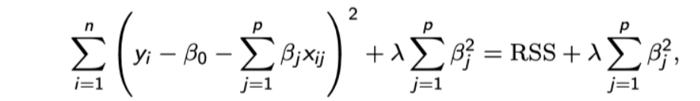
For Shrinkage, Method 1:- Ridge Estimator
Ridge Estimator:-
This cost function is valid for linear regression only. *
The larger the latter, the more our model will be simple and inverted. The penalizing term λ∑β ^ 2 is called "shrinkage penalty" and becomes small when the coefficients of our estimators are close to 0.

Slide 10
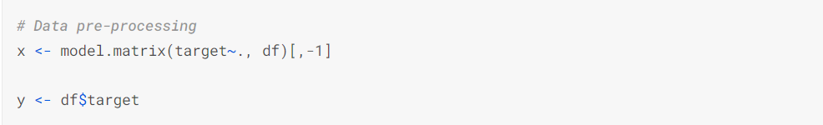
Method 1:- Ridge Estimator
To find the optimal lambda, we have to cross-validate.

Slide 11
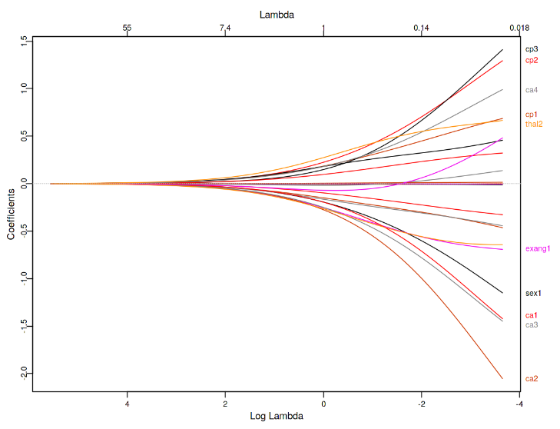
Method 1:- Ridge Estimator

Slide 12
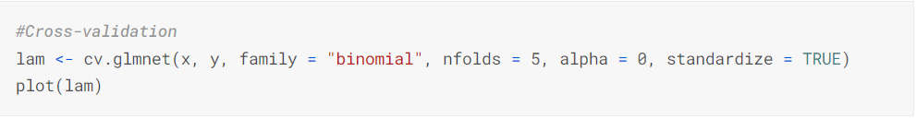
Method 1:- Ridge Estimator
We see here the evolution of the value of our coefficients as a function of lambda. What is interesting to see here is that the variables CA and CP are the most significant. However, the method does not allow us to see which variables to choose.
Here, we will see how to find the optimal lambda and thus minimize the cost function of our model.

Slide 13
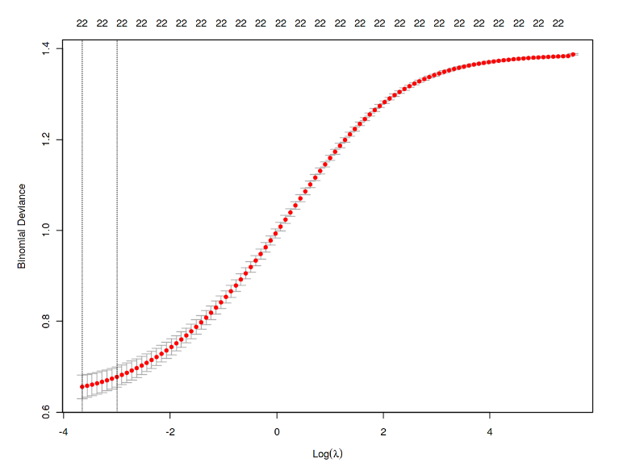
Method 1:- Ridge Estimator

Slide 14
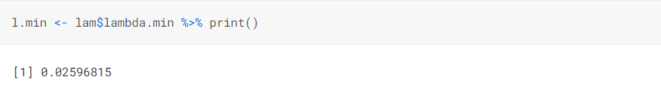
Method 1:- Ridge Estimator
We see here that we minimize our cost function with lambda = 0.0026. Given that our model is a classification, the cost function is Deviance and not RSS as in the case of a regression.

Slide 15
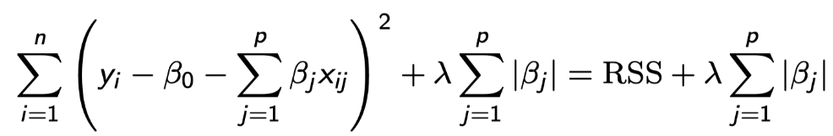
Method 2: Lasso
The big difference with the Ridge estimator is that here the value of the coefficients may be so penalized that it can be zero. This will therefore act as a means of selecting the variables of our model.
Here is the new cost function:-
You will notice that the essential difference with the Ridge method is that we apply an absolute value and not a square for our estimator B.
For the creation of the model, the difference is that we will set alpha = 1 instead of 0

Slide 16
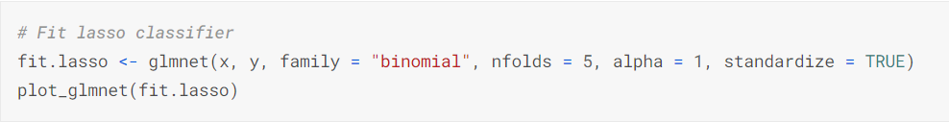
Method 2: Lasso
If you compare with the graph of the ridge method, the difference is quite significant. The importance of the regressors does not necessarily change but the value of the coefficients is very different and will especially be much more penalized. Here, it would rather be necessary to select the variables Thal, CA and CP which remains a result relatively similar to the ridge method.

Slide 17
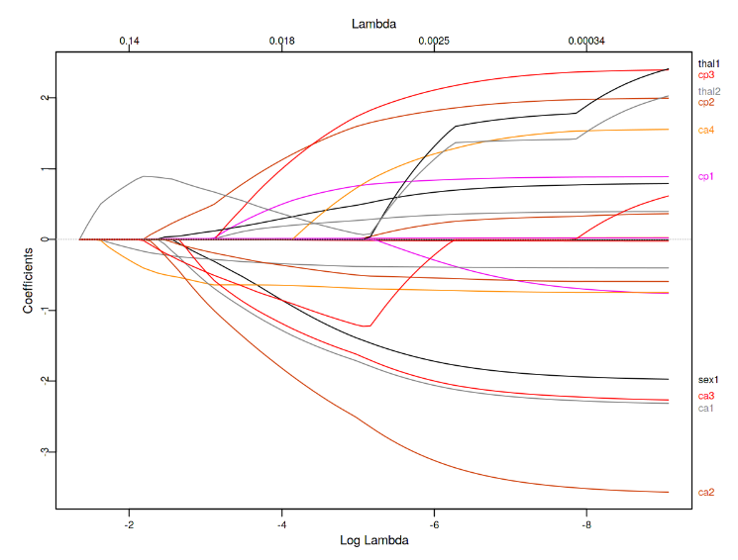
Method 2: Lasso

Slide 18
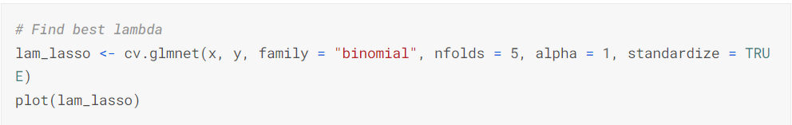
Method 2: Lasso
#pic from
Obviously, the optimal lambda is no longer the same with this method!

Slide 19
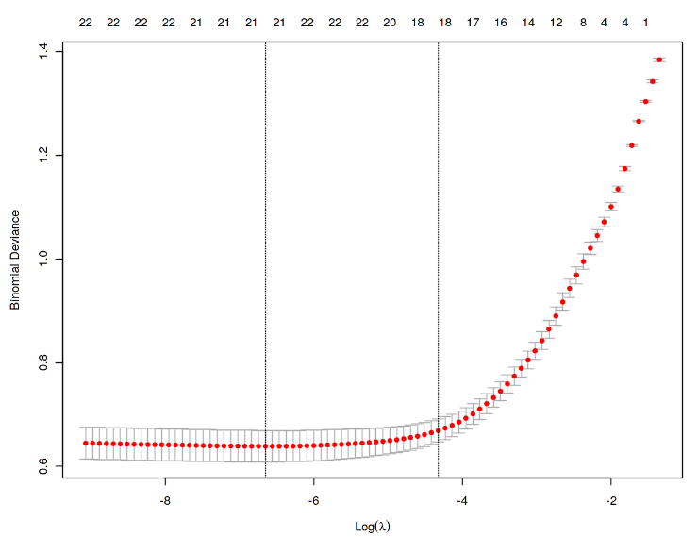
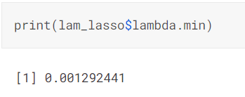
Method 2: Lasso

Slide 20
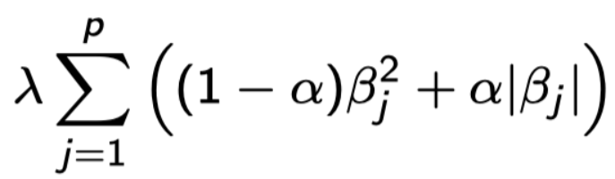
Method 3: Elastic-net
The main defect of the LASSO method is that in some cases it can be too penalizing. In addition, the correlation between 2 variables can have the consequence that the coefficients of the other variables are too much penalized, unlike the correlated variables. Therefore, we use the Elastic-net method which will combine the Ridge and LASSO method.
The penalizing term therefore becomes:
This method was created by Zou and Hastie in 2005.

Slide 21
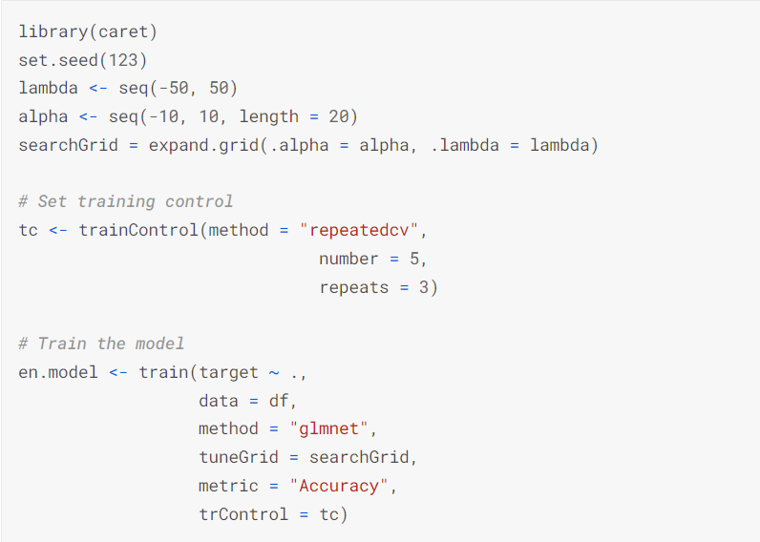
Method 3: Elastic-net
The implementation of the method is no longer done with the glmnet package but with caret:

Slide 22
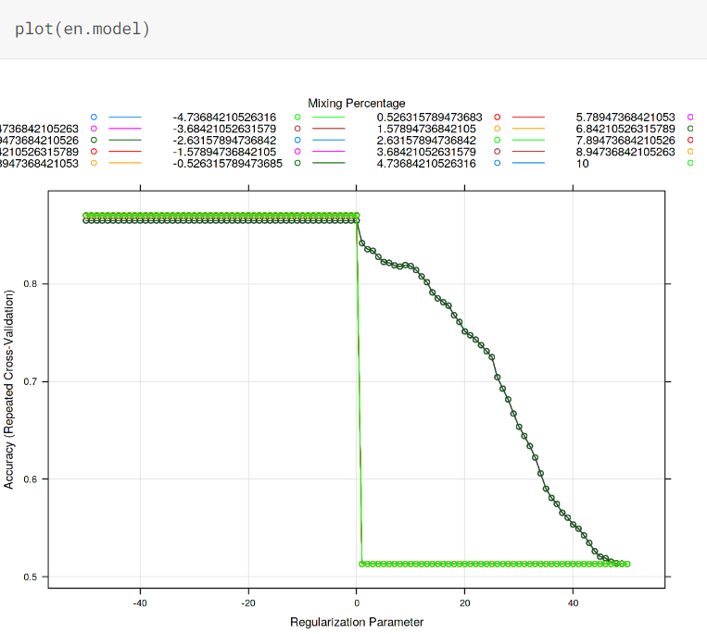
Method 3: Elastic-net

Slide 23
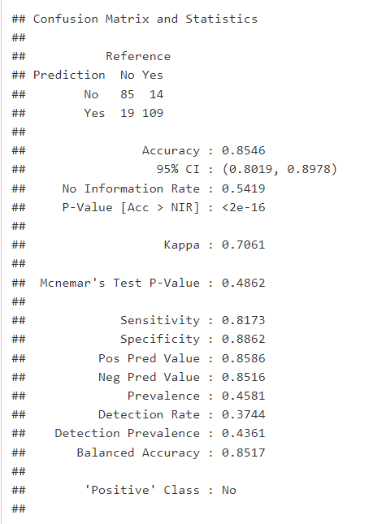
Method 4: Bayesian Algorithm
Checking the model with training data and creating its confusion matrix to know how accurate the model is.

Slide 24
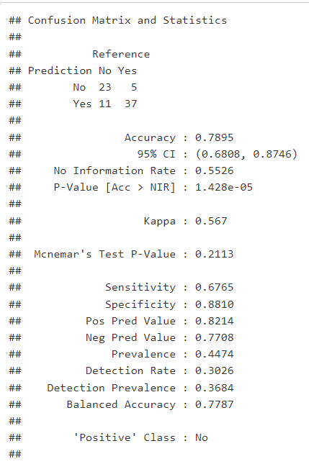
Method 4: Bayesian Algorithm

Slide 25

Method 4: Bayesian Algorithm
we can conclude that the model generated with help of Bayes algorithm is 78.95% accurate or we can also say that the misclassification rate for Bayes algorithm is 21.05%.

Slide 26
Conclusion
To conclude, we can say the feature selection methods are multiple and will mainly depend on the data and what you seek to do with it. In the case of data with little variance, a regression ridge can give very satisfactory results. If you are looking to select variables, the lasso estimator would be the best approach. More generally, the elastic-net method is probably the one that will give the best results in many cases, but it is not necessarily the one to be used first. The Bayesian approach gives a good accuracy of about 78.95%.

Slide 27
References
https://rpubs.com/Ray0705/heartdiseaseprediction
https://rpubs.com/elaliberte/FreqBayes

Slide 28
Thank you !

